Slide 1
Chapter 13: Schedules of Reinforcement

Slide 2
Concurrent performances: formalizing the matching law
Concurrent interval schedules
Participants typically do not allocate all of their responses exclusively to the richer schedule
Concurrent ratio schedules
Participants are sensitive to the ratio schedules an tend to maximize reinforcement by responding primarily to the ratio that produces the higher rate of reinforcement

Slide 3
Matching law
Rate of responding typically is proportional to the rate of reinforcement received from each choice alternative

Slide 4
Discriminative Schedules of Reinforcement
Multiple Schedules of Reinforcement (mult)
Presents two or more basic schedules of reinforcement in an alternating, usually random, sequence
Basic schedules occur successively & independently
A discriminative stimulus is correlated with each basic schedule and is present as long as the schedule is in effect

Slide 5
Discriminative Schedules of Reinforcement
Chained Schedules of Reinforcement (chain)
Basic schedules occur in a specific order
The behavior may be the same for all elements of the chain, or different behaviors may be required for different elements
Conditioned reinforcement for first behavior in the chain is the presentation of the second element and so on

Slide 6
Non-discriminative Schedules of Reinforcement
Mixed Schedules (mix)
Identical to multiple schedules, except the mixed schedule has no discriminative stimuli correlated with the independent schedules
Example: mix FR 10 FI 1 schedule

Slide 7
Non-discriminative Schedules of Reinforcement
Tandem Schedules
Similar to the chained schedule except the tandem schedule does not use a discriminative stimulus
Example: FR 15 FI 2 schedule – participants makes 15 responses then reinforcement is delivered for the first response after 2 minutes of elapsed time.

Slide 8
Ch. 14-15: Positive & Negative Punishment

Slide 9
Defining Punishment
You cannot define punishment based upon what appears “favorable” or “unfavorable”.
You cannot define punishment based upon how you think it would affect your own behavior.
Does not involve a retribution or intent to harm a wrongdoer
Must define a punisher based upon the effect it has on the future probability of behavior

Slide 10
Punishment
A process by which the consequence of a response DECREASES the future probability of that response.
Two types of punishment
POSITIVE punishment: The consequence of behavior involves the addition of a stimulus
NEGATIVE punishment: The consequence of behavior involves the subtraction of a stimulus

Slide 11
Antecedent Stimuli for Punishment
Discriminative stimulus for punishment (S^{Dp})
A stimulus condition in the presence of which a response has a lower probability of occurrence than it does in its absence as a result of response-contingent punishment delivery in the presence of the stimulus
Antecedent stimulus that is present when the behavior is punished
S^{Dp} →Behavior→Punisher
Notes:
So now that we know the types of punishment, lets look at the antecedent stimuli that controls behavior under punishment…
You all know that a discriminative stimulus for reinforcement is …
An SD for punishment does the complete opposite, that is, it makes the behavior LESS probable in the presence of that stimulus.
So if an SD for punishment makes the behavior less probable, then an S-delta for punishment will make the behavior MORE probable in the presence of that stimulus…
Let me explain how this works......
Have you ever gone through an emergency exit door?

Slide 12
Antecedent Stimuli for Punishment
S-delta for punishment (S^{∆ p})
Antecedent stimulus that is present when the behavior is not punished
S^{∆ p} →Behavior→ No Punisher

Slide 13
Antecedent Stimuli for Punishment
Example
A B C
Mom Talk with mouth full Reprimand
Dad Talk with mouth full No reprimand
You are less likely to talk with your mouth full when Mom is present than with Dad

Slide 14
Putting it in Perspective: Operant Conditioning
Operant conditioning = modification by consequences
 | Presentation of stimulus | Removal of stimulus
Increase probability of behavior | Positive Reinforcement | Negative Reinforcement
Decrease probability of behavior | Positive Punishment | Negative Punishment
Consequences of operant behavior

Slide 15
Types of punishers
Unconditioned vs. Conditioned
Unconditioned (aka natural, primary): Those that we are born predisposed to (e.g., pain, aversive temperatures)
Conditioned: Those that gain punishing value during the course of ones life due to associations with primary punishers (e.g., reprimands, removal of money)
Social vs. Automatic
Social: Requires another person (e.g., point removal)
Automatic: Produced from the response itself (e.g., running into a tree “automatic”ally produces pain)

Slide 16
Positive Punishment
No stimulus
Behavior
Stimulus added
Antecedent Behavior Consequence
No pain
Place hand on stove
Pain
Not sick
Eat rotten food
Sick
No ticket
Exceed speed limit
Ticket

Slide 17
Response blocking
Physically intervening as soon as the person begins to emit the problem behavior to prevent or “block” the completion of the response has been show to be effective in reducing the frequency of some problem behaviors
Suppressive effects of response blocking may be due to punishment or to extinction

Slide 18
overcorrection
A behavior change tactic based on positive punishment in which, contingent on the problem behavior, the learner is required to engage in effortful behavior that is directly or logically related to the problem
2 Forms:
Restitutional
Positive Practice

Slide 19
Restitutional overcorrection
Contingent on the problem behavior, the learner is required to repair or return the environment to its original state and then to engage in additional behavior to bring the environment to a condition vastly better than it was in prior to the misbehavior

Slide 20
Positive practice
Contingent on an occurrence of the target behavior the learner is required to repeat a correct form of the behavior, or a behavior incompatible with the problem, a specified number of times

Slide 21
Negative Punishment
Stimulus
Behavior
Stimulus removed
Antecedent Behavior Consequence
License
Get a DUI
License removed
Place on roof of car +
Drive away
MacBook Laptop removed
MacBook Laptop
Toys
Aggress towards peer
Toy removed

Slide 22
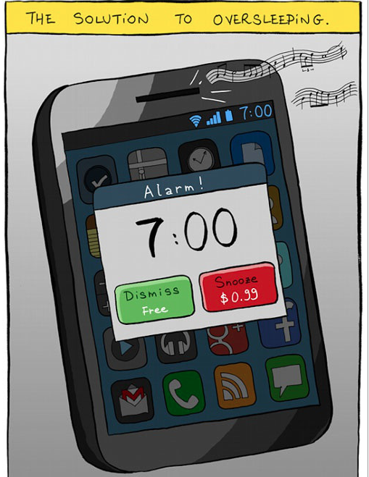

Slide 23
Time Out
The withdrawal of the opportunity to earn positive reinforcement
The loss of access to reinforcers for a specified period of time
Loss of opportunity to earn reinforcers for a temporary period of time
The discrepancy between “time-out” and “time-in” must be great
Notes:
Actually did not reinforcing.
Sitting on the chair can not move.
Sure what is available.
A punisher

Slide 24
Time out procedures
Nonexclusion
Planned ignoring
Withdrawal of a specific positive reinforcer
Contingent observation
Time-out ribbon
Exclusion
Time-out room
Partition time-out
Hallway time-out

Slide 25
Response cost
Loss of a specific amount of reinforcement (may be permanent)
Examples: reclaiming awards or stickers, “fines” (e.g., loss of tokens or money)

Slide 26
Response cost
Produces rapid decreases in the target behavior
Convenient & easy to implement (can be incorporated into existing token or allowance programs)
Is easily combined with other approaches (such as differential reinforcement)
Notes:
Make sure do not go down to 0

Slide 27
Types of Response cost
Direct fine
Bonus response cost
Combined with positive reinforcement
Group arrangements

Slide 28
Effective use of response cost
Specifically define the target behaviors that will result in response cost, as well as the fines
Establish rules for refusals to comply with the response-cost procedure, and explain these
Greater fines should be associated with more severe forms of problem behavior
Be cautious of making fines so great that the individual becomes “bankrupt”

Slide 29
Effective use of response cost
Fines should be posed immediately
Response cost vs. bonus response cost
Use least aversive initially (bonus response cost)
Increases acceptability
Decreases emotional outbursts
Ensure reinforcement reserve (decrease likelihood of “bankruptcy”)
Notes:
Opportunity losing, opportune getting back

Slide 30
Effective use of response cost
Be prepared for unplanned or unexpected outcomes
Response cost can reinforce rather than punish undesirable behavior
Individuals can refuse to give up positive reinforcers
Avoid overuse
Keep records to evaluate effectiveness
Notes:
Jail: Use to punish
Reinforcing, assess to food, bed.

Slide 31
Practice Time!
Juan teases and hits his sisters until they cry. His mother scolds him and spanks him each time he teases or hits his sisters. Although Juan stops teasing and hitting his sisters at the moment that his mother scolds him and spanks him, he continues to engage in these aggressive and disruptive behaviors with his sister day after day.
Is scolding and spanking by his mother a punisher for Juan’s aggressive and disruptive behavior? Why or why not?

Slide 32
Factors that Influence the Effectiveness of punishment
Immediacy: Immediacy > Delayed
Contingency: Contingent > Noncontingent
Consistency: Continuous > Intermittent
Magnitude: More intense > Less intense
Competition with ongoing sources of reinforcement
Is there a really strong source of reinforcement for the behavior? May “over-ride” your punishment attempt?
Notes:
Drinking!!! Delay punisher, Hangover immediately, -> social reinforcement

Slide 33
Potential harmful side effects of punishment
Aggressive/emotional behavior
Escape/avoidance behavior
No new behavior
Modeling of punishment
Overuse of punishment
Generalized suppression: behaviors other than the undesired target behavior decrease

Slide 34
Potential harmful side effects of punishment
Behavior contrast
Reduced responding from punishment in one setting or situation may be accompanied by increased responding in another setting or situation in which responses go unpunished

Slide 35
Recovery from punishment
When punishment is discontinued, its suppressive effects on responding are usually not permanent
Sometimes the rate of responding after punishment is discontinued will not only recover but also briefly exceed the level at which it was occurring prior to punishment

Slide 36
Recovery from punishment
Permanent response suppression may occur when complete suppression of behavior to a zero rate of responding has been achieved with intense punishment

Slide 37
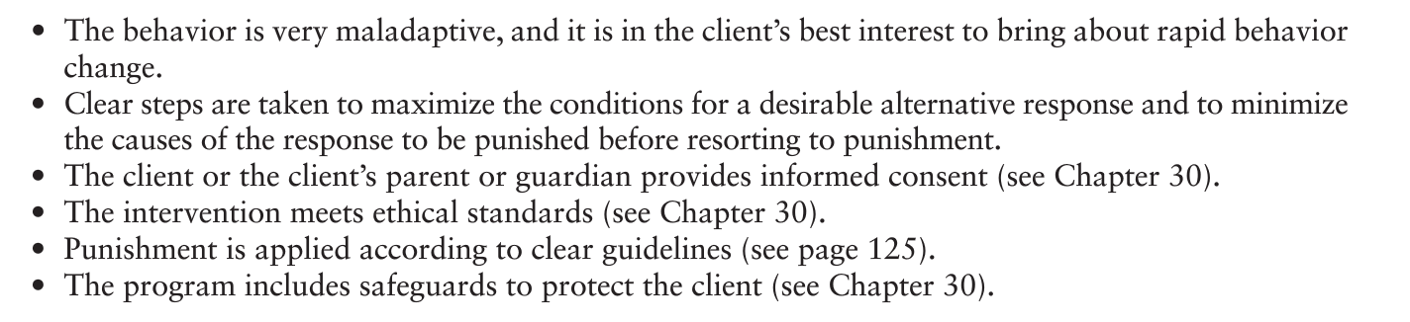
Should Punishment be used?
Right-to-effective-treatment position
Punishment typically results in rapid suppression
Freedom-from-harm position
Non-aversive procedures may be equally effective and less intrusive
Punishment happens
Know the laws/regulations/guides/rules!
Only consider using punishment when…

